Slide 1
Reducing Bank Customer Churn
Leveraging Data Analysis and Predictive Modeling

Slide 2

Key Idea
Random forest model most effective in predicting customer churn
AdaBoost model better for identifying customers at risk of churning
Utilize models for proactive retention strategies
Photo by Pexels

Slide 3

Implement Proactive Retention Strategies
Use models to identify customers at risk of churning
Develop targeted retention strategies
Personalized offers, improved customer service, or loyalty programs
Photo by Pexels

Slide 4

Enhance Customer Experience
Analyze customer satisfaction scores and complaints
Improve complaint resolution processes
Address customer pain points
Photo by Pexels

Slide 5

Segment Customers and Tailor Communication
Segment customers based on factors such as age, balance, and tenure
Tailor communication and marketing campaigns to each segment
Provide relevant offers and information to cater to specific needs and preferences
Photo by Pexels

Slide 6

Optimize Credit Card Offerings
Analyze relationship between card type, points earned, and churn
Promote card types associated with higher customer retention
Offer incentives and rewards to encourage credit card usage
Photo by Pexels

Slide 7

Continuously Monitor and Refine Models
Regularly update and refine models as new data becomes available
Monitor performance metrics such as accuracy, precision, and recall
Incorporate feedback and insights from business stakeholders to improve models
Photo by Pexels

Slide 8

Call to Action
Implement recommended strategies to reduce customer churn
Utilize data analysis and predictive modeling to proactively identify customers at risk of churning
Maintain a loyal customer base, enhance customer satisfaction, and drive business growth and profitability
Photo by Pexels

Slide 9
Q & A

Slide 10
Appendix

Slide 11
Data Cleaning and Preprocessing

Slide 12
Dataset:
- RowNumber: corresponds to the record (row) number and has no effect on the output.
- CustomerId: contains random values and has no effect on customer leaving the bank.
- Surname: the surname of a customer has no impact on their decision to leave the bank.
- CreditScore: can have an effect on customer churn, since a customer with a higher credit score is less likely to leave the bank.
- Geography: a customer’s location can affect their decision to leave the bank.
- Gender: it’s interesting to explore whether gender plays a role in a customer leaving the bank.
- Age: this is certainly relevant, since older customers are less likely to leave their bank than younger ones.
- Tenure: refers to the number of years that the customer has been a client of the bank. Normally, older clients are more loyal and less likely to leave a bank.
- Balance: also a very good indicator of customer churn, as people with a higher balance in their accounts are less likely to leave the bank compared to those with lower balances.
- NumOfProducts: refers to the number of products that a customer has purchased through the bank.
- HasCrCard: denotes whether or not a customer has a credit card. This column is also relevant, since people with a credit card are less likely to leave the bank.
- IsActiveMember: active customers are less likely to leave the bank.
- EstimatedSalary: as with balance, people with lower salaries are more likely to leave the bank compared to those with higher salaries.
- Exited: whether or not the customer left the bank.
- Complain: customer has complaint or not.
- Satisfaction Score: Score provided by the customer for their complaint resolution.
- Card Type: type of card hold by the customer.
- Points Earned: the points earned by the customer for using credit card.

Slide 13
Data Cleaning:
Removed irrelevant columns: RowNumber, CustomerId, Surname.
data = data.drop(['RowNumber', 'CustomerId', 'Surname'], axis=1)
Dropped highly correlated variables: Complain
data = data.drop('Complain', axis=1)

Slide 14
Preprocessing Techniques:
Converted categorical variables to numerical using one-hot encoding.
data = pd.get_dummies(data, columns=['Geography', 'Gender', 'Card Type'], drop_first=True)
Scaled numerical variables using StandardScaler to ensure comparability.
scaler = StandardScaler()
X_train = scaler.fit_transform(X_train)
X_test = scaler.transform(X_test)

Slide 15
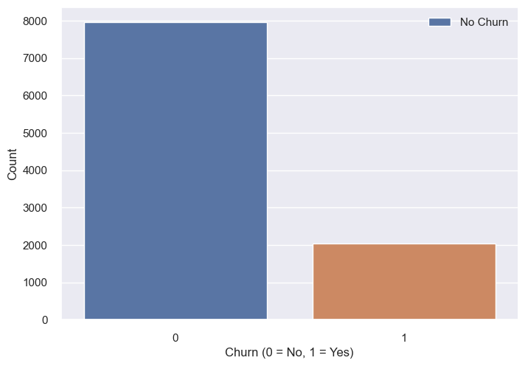
Churn vs No Churn:
Number of customers who exited (1 = Yes) vs the number of customers who stayed (0 = No)
sns.countplot(x='Exited', data=data)
plt.xlabel('Churn (0 = No, 1 = Yes)')
plt.ylabel('Count')
plt.legend(labels=['No Churn', 'Churn'])
plt.show()

Slide 16
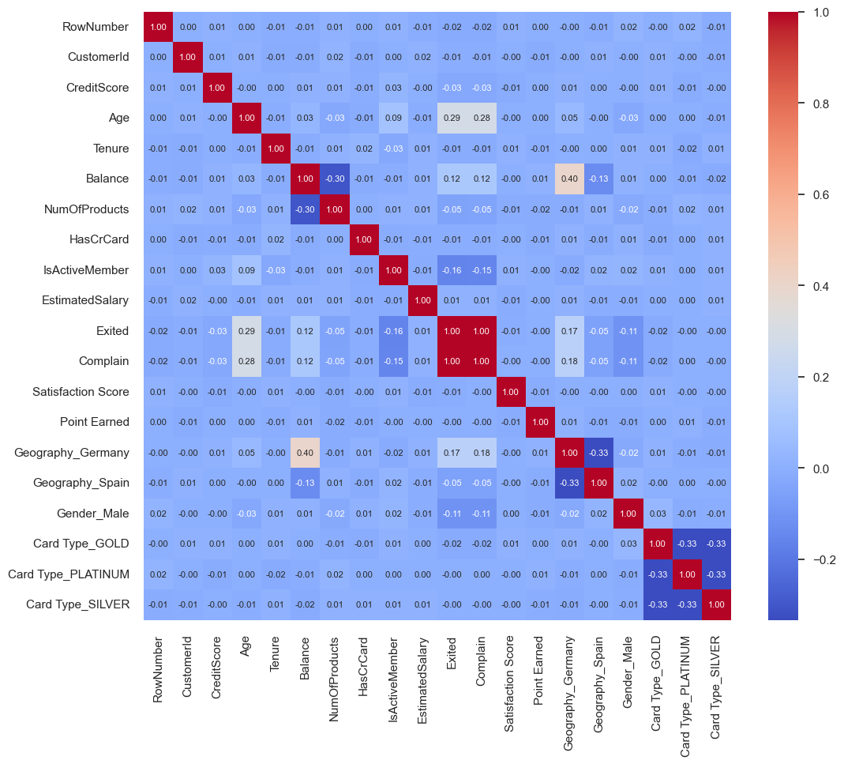
Correlation Matrix
Heatmap to visualize the correlation matrix between variables
plt.figure(figsize=(12,10))
sns.heatmap(data.corr(), annot=True, cmap='coolwarm', fmt='.2f', annot_kws={'fontsize':8})
plt.show()

Slide 17
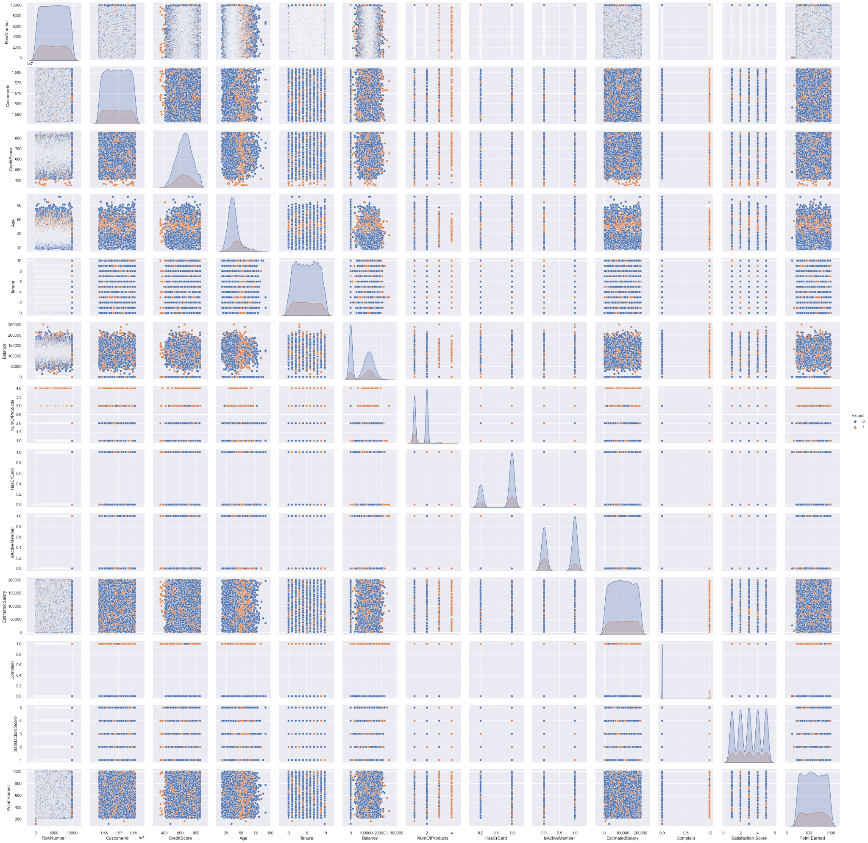
Numerical Variables
Pairplot to show the relationship between numerical variables and churn
sns.pairplot(data=data, hue='Exited')
plt.show()

Slide 18
Analysis of Relationships

Slide 19
Business Questions:
What are the main factors driving customer churn in the bank?
How can we identify customers who are at a higher risk of churning?
Are there specific customer segments that are more prone to churn?
What is the impact of customer satisfaction and complaint resolution on churn rates?
Are there differences in churn rates based on geographical location or gender?
How does the number of products a customer has purchased affect their likelihood of churn?
Does the tenure of a customer have an impact on their churn behavior?
What role does the customer's credit score play in their decision to churn?
How do factors such as account balance, credit card ownership, and salary influence churn rates?
Can we predict customer churn accurately using machine learning models?
What retention strategies can be implemented to reduce churn and improve customer loyalty?
How can personalized marketing initiatives be used to retain high-value customers?
What external factors, such as economic conditions or industry trends, might affect customer churn rates?
What are the financial implications of customer churn for the bank?
How can the bank optimize its product and service offerings to reduce churn and increase customer retention?

Slide 20
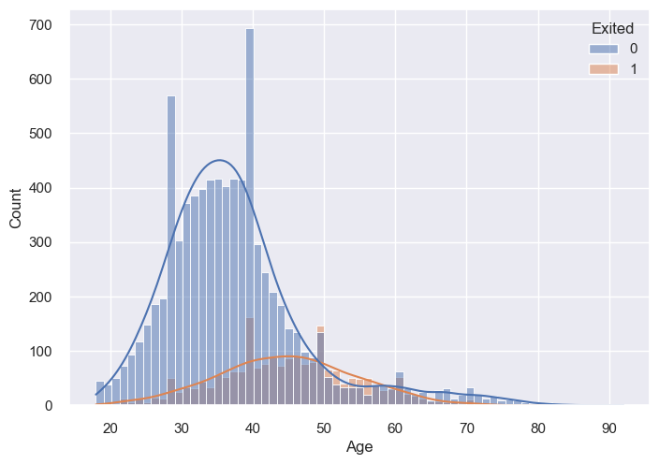
Age and Churn:
Analyzed the relationship between customer age and churn.
Found that older customers were less likely to churn compared to younger ones.
sns.histplot(data=data, x='Age', hue='Exited', kde=True)
plt.show()

Slide 21
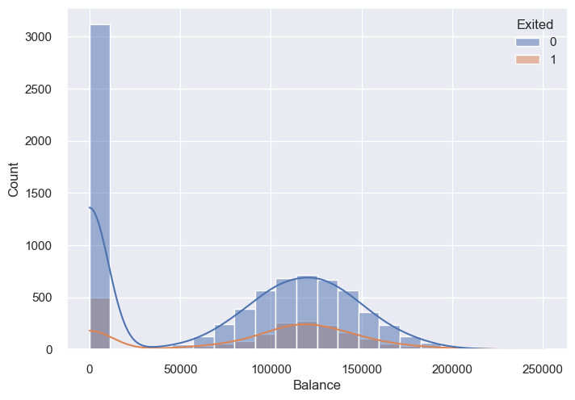
Balance and Churn:
Explored the association between customer balance and churn.
Discovered that customers with balances between $100,000 to $150,00 were more likely to churn.
sns.histplot(data=data, x='Balance', hue='Exited', kde=True)
plt.show()

Slide 22
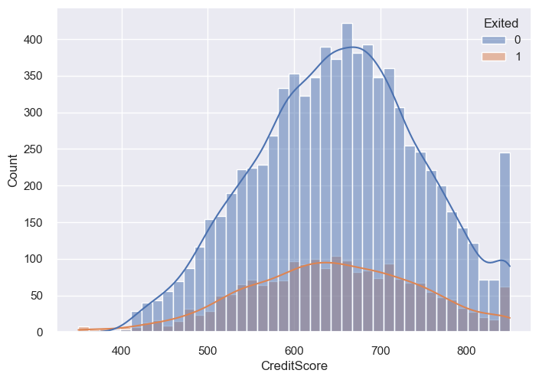
Credit Score and Churn:
Explored the association between credit score and churn.
Discovered that customers with credit scores between 600 to 700 were more likely to churn.
sns.histplot(data=data, x='CreditScore', hue='Exited', kde=True)
plt.show()

Slide 23
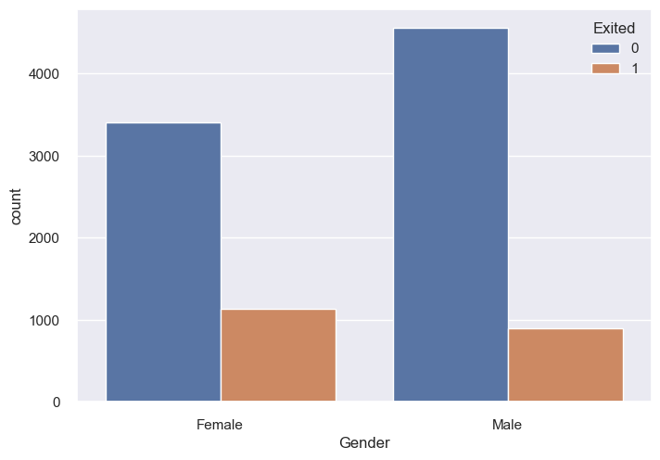
Gender and Churn:
Assessed if there were any gender-based differences in churn rates.
Found that female customers were more likely than male customers.
sns.countplot(x='Gender', hue='Exited', data=data)
plt.show()

Slide 24
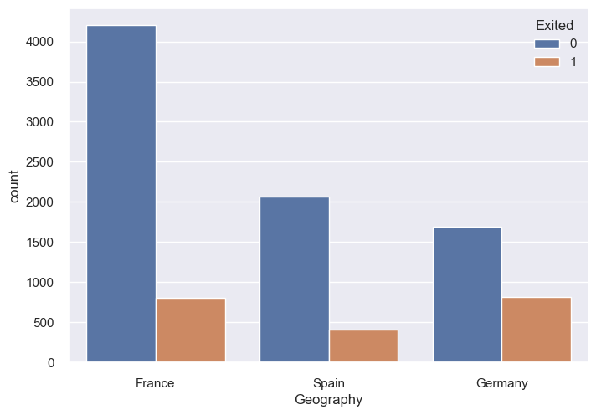
Geographical Influence:
Explored the churn rates across different geographical regions (France, Germany, Spain).
Analyzed if there were any significant variations in churn based on the customer's location.
Customers in Spain were less likely to churn, while Germany had the highest.
sns.countplot(x='Geography', hue='Exited', data=data)
plt.show()

Slide 25
Model Building and Evaluation

Slide 26
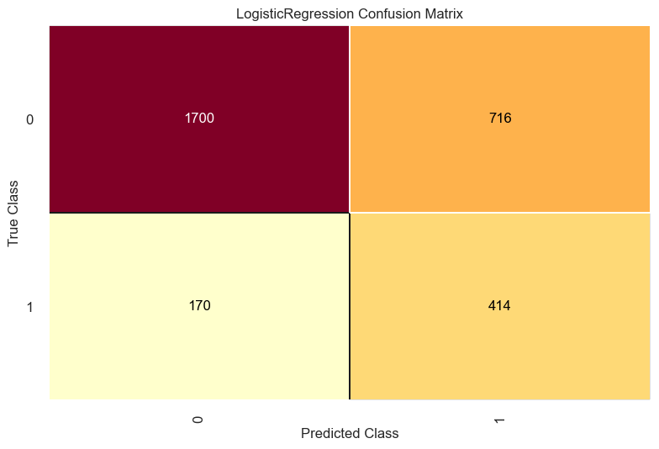
Logistic Regression Confusion Matrix:
The confusion matrix shows that the model correctly predicted 1700 true negatives and 414 true positives, but made 716 false negatives and 170 false positives.
cm = ConfusionMatrix(logistic)
cm.fit(X_train, y_train)
cm.score(X_test, y_test)
cm.show()

Slide 27
Logistic Regression Classification Report:
The accuracy score of the logistic regression model is 0.705.
The classification report shows that the model has a higher precision for the negative class (0.91) than the positive class (0.37)
The F1-score is higher for the negative class (0.79) than the positive class (0.48), indicating that the model performs better at predicting the negative class.
 | precision | recall | f1-score | support
0 | 0.91 | 0.70 | 0.79 | 2416
1 | 0.37 | 0.71 | 0.48 | 584
accuracy |  |  | 0.70 | 3000
macro avg | 0.64 | 0.71 | 0.64 | 3000
weighted avg | 0.80 | 0.70 | 0.73 | 3000

Slide 28

Gaussian Naive Bayes Confusion Matrix:
The confusion matrix shows that the model correctly predicted 403 true negatives and 1760 true positives, but made 656 false positives and 181 false negatives.
cm = ConfusionMatrix(naive_bayes)
cm.fit(X_train, y_train)
cm.score(X_test, y_test)
cm.show()

Slide 29
Gaussian Naive Bayes Classification Report:
The accuracy score of the logistic regression model is 0.721.
The classification report shows that the model has a higher precision for the negative class (0.91) than the positive class (0.38).
The F1-score is higher for the negative class (0.81) than the positive class (0.49), indicating that the model performs better at predicting the negative class.
 | precision | recall | f1-score | support
0 | 0.91 | 0.73 | 0.81 | 2416
1 | 0.38 | 0.69 | 0.49 | 584
accuracy |  |  | 0.72 | 3000
macro avg | 0.64 | 0.71 | 0.65 | 3000
weighted avg | 0.80 | 0.72 | 0.75 | 3000

Slide 30
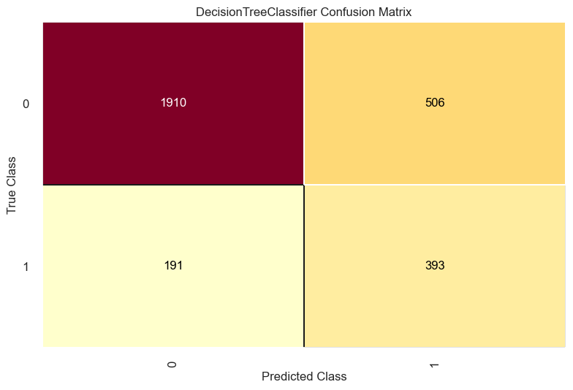
Decision Tree Confusion Matrix:
The confusion matrix shows that the model correctly predicted 393 true negatives and 1910 true positives, but made 506 false positives and 191 false negatives.
cm = ConfusionMatrix(decision_tree)
cm.fit(X_train, y_train)
cm.score(X_test, y_test)
cm.show()

Slide 31
Decision Tree Classification Report:
The accuracy score of the logistic regression model is 0.768.
The classification report shows that the model has a higher precision for the negative class (0.91) than the positive class (0.44).
The F1-score is higher for the negative class (0.85) than the positive class (0.53), indicating that the model performs better at predicting the negative class.
 | precision | recall | f1-score | support
0 | 0.91 | 0.79 | 0.85 | 2416
1 | 0.44 | 0.67 | 0.53 | 584
accuracy |  |  | 0.77 | 3000
macro avg | 0.67 | 0.73 | 0.69 | 3000
weighted avg | 0.82 | 0.77 | 0.78 | 3000

Slide 32
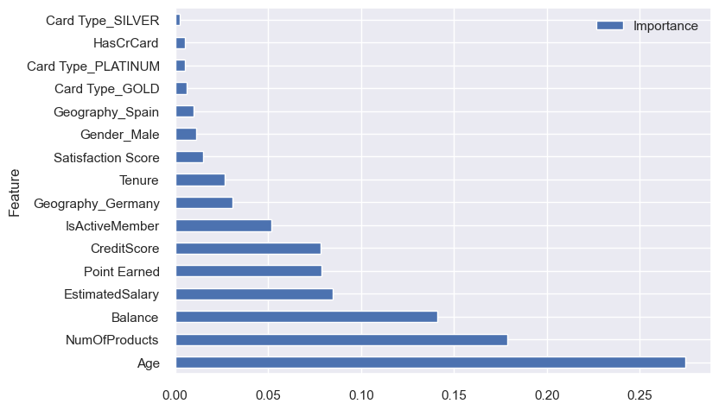
Decision Tree Feature Importance:
The model results show that the most important features are `Age`, `Balance`, `NumOfProducts`, and `EstimatedSalary`.

Slide 33
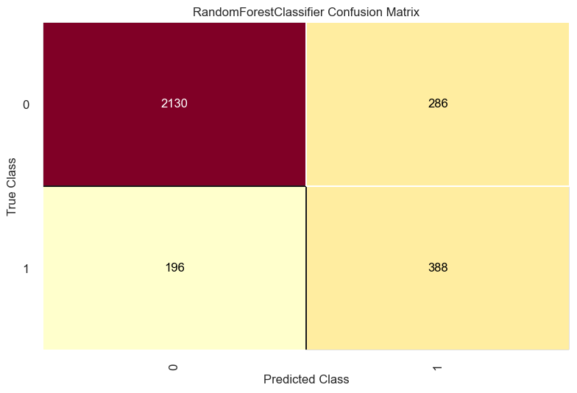
Random Forest Confusion Matrix:
The confusion matrix shows that the model correctly predicted 388 true negatives and 2130 true positives, but made 286 false positives and 196 false negatives.
cm = ConfusionMatrix(random_forest)
cm.fit(X_train, y_train)
cm.score(X_test, y_test)
cm.show()

Slide 34
Random Forest Classification Report:
The accuracy score of the logistic regression model is 0.839.
The classification report shows that the model has a higher precision for the negative class (0.92) than the positive class (0.58).
The F1-score is higher for the negative class (0.90) than the positive class (0.62), indicating that the model performs better at predicting the negative class.
 | precision | recall | f1-score | support
0 | 0.92 | 0.88 | 0.90 | 2416
1 | 0.58 | 0.66 | 0.62 | 584
accuracy |  |  | 0.84 | 3000
macro avg | 0.75 | 0.77 | 0.76 | 3000
weighted avg | 0.85 | 0.84 | 0.84 | 3000

Slide 35
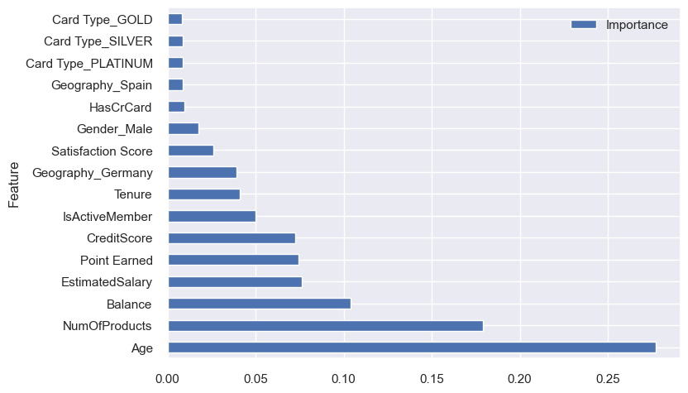
Random Forest Feature Importance:
The model results show that the most important features are `Age`, `NumOfProducts`, `Balance`, and `EstimatedSalary`.

Slide 36

Adaboost Confusion Matrix:
The confusion matrix shows that the model correctly predicted 426 true negatives and 1952 true positives, but made 464 false positives and 158 false negatives.
cm = ConfusionMatrix(ada_boost)
cm.fit(X_train, y_train)
cm.score(X_test, y_test)
cm.show()

Slide 37
AdaBoost Classification Report:
The accuracy score of the logistic regression model is 0.79.
The model has a higher precision for the negative class (0.93) than the positive class (0.48).
The F1-score is higher for the negative class (0.86) than the positive class (0.58), indicating that the model performs better at predicting the negative class.
 | precision | recall | f1-score | support
0 | 0.93 | 0.81 | 0.86 | 2416
1 | 0.48 | 0.73 | 0.58 | 584
accuracy |  |  | 0.79 | 3000
macro avg | 0.70 | 0.77 | 0.72 | 3000
weighted avg | 0.84 | 0.79 | 0.81 | 3000

Slide 38
Model Evaluation:
Model | Accuracy Score | Precision Score
Random Forest | 0.839333 | 0.92
AdaBoost | 0.792000 | 0.93
Decision Tree | 0.767667 | 0.91
Naive Bayes | 0.721000 | 0.91
Logistic Regression | 0.704667 | 0.91
models = pd.DataFrame({ 'Model': ['Logistic Regression', 'Naive Bayes', 'Decision Tree', 'Random Forest', 'AdaBoost'],
'Score': [logistic_accuracy, naive_bayes_accuracy, decision_tree_accuracy, random_forest_accuracy, ada_boost_accuracy]})
models.sort_values(by='Score', ascending=False)

Slide 39
References
1. Customer Churn - EDA, Balancing and ML (83.63%)
https://www.kaggle.com/code/raphaelmarconato/customer-churn-eda-balancing-and-ml-83-63
2. How to handle Imbalanced Data in machine learning classification
https://www.justintodata.com/imbalanced-data-machine-learning-classification/

